Slide 1
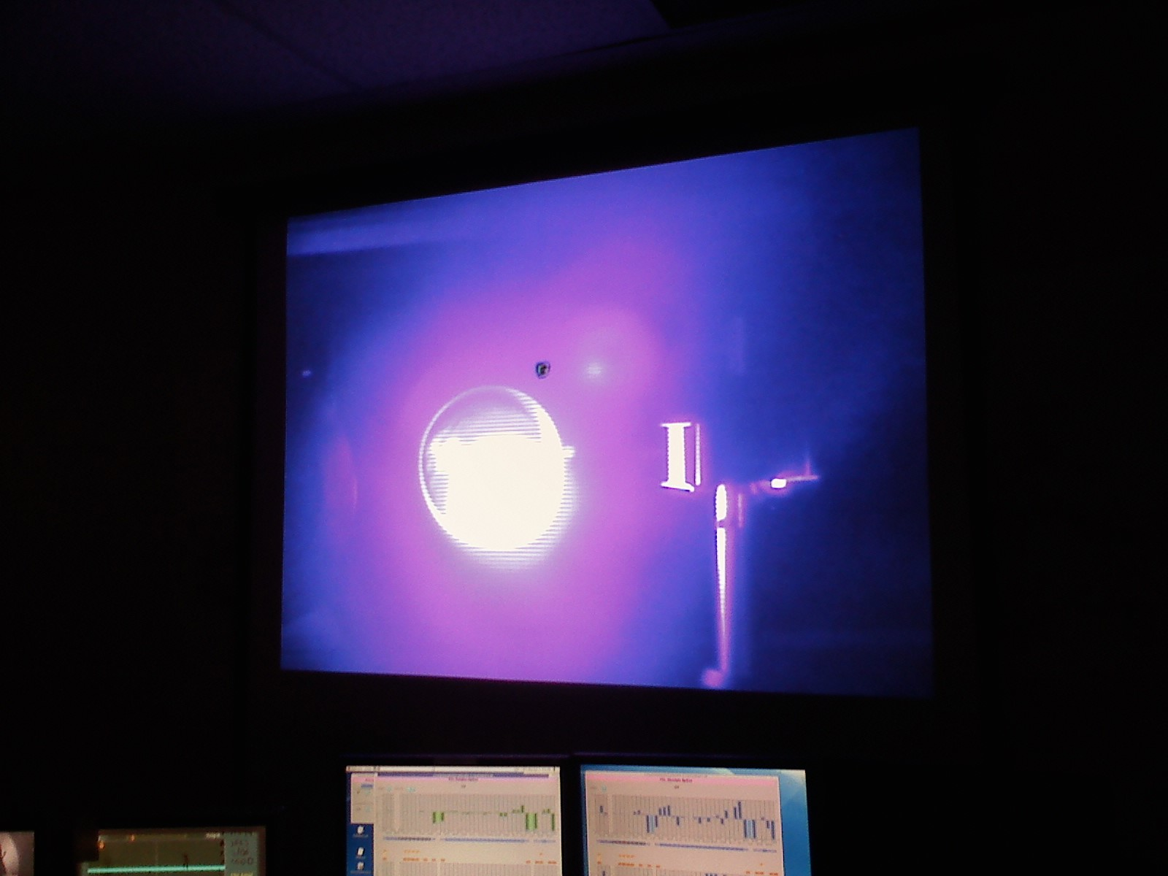
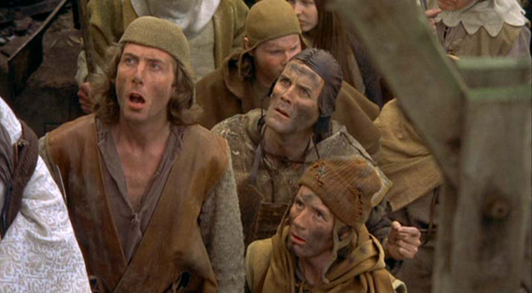
The JLab IR/UV FEL Driver
D. Douglas for the
JLab FEL anarcho-syndicalist commune

Slide 2
ERL Configuration & Performance
E~80-135 MeV
I~10 mA (135 pC x 75 MHz)
ε_{N}^{transverse} ~ 5-10 mm-mrad
(charge dependent)
ε_{N}^{tlongitudinal} ~ 50-100 keV-psec
(charge dependent)
Flexible large-acceptance transport system
- transverse and longitudinal matching
* variable spot size, bunch length, dp/p
- phase-space exchange (IR side)

Slide 3
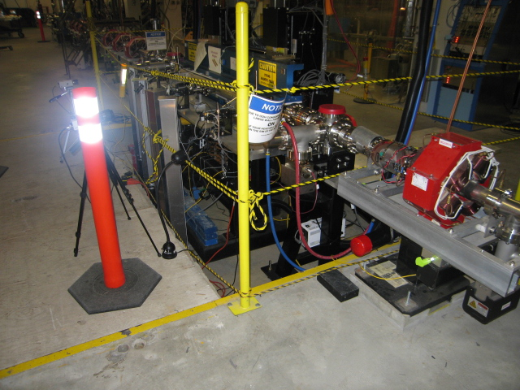
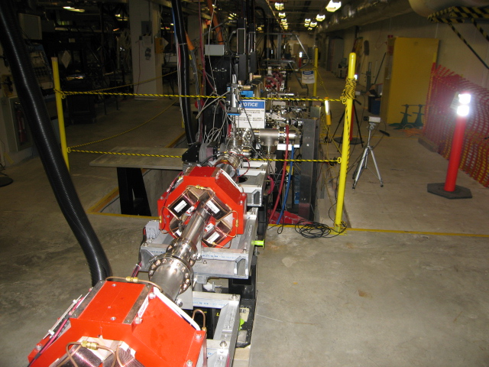
Key Features
DC photocathode gun
High brightness CW beam
SRF ERL system architecture
High power/high current
Large acceptance
optimized for momentum acceptance (FEL exhaust beam)
physical and dynamic (transverse&longitudinal) acceptance fairly large
3” pipe in straights, ~1’ at high dispersion points
Good aberration control
UV bypass has “natural” location for detector
“wiggler pit” (photos from J. Boyce/A. Kelleher)

Slide 4
Practical Consequences
Very bright, extremely high power e⁻ beam
Operationally flexible
=> can run as NP testbed as well as FEL driver
e.g. rework longitudinal match to produce small momentum spread rather than short bunch
and thus produce moderately small spot size and small momentum spread
At 60 pC (UV “native” mode)
σ_{δp/p} ~ 0.025%
σ_{x,y} ~ 0.05 mm

Slide 5
Requirements/Issues for DarkLight
Requirements
Service gas jet target
Small spot size (target aperture constraint)
good beam stability
low background
Accommodate detector
Use UV wiggler pit (?)
High current
Energy recovery
Large spatial/energy acceptance after target/loss management
Issues
Aperture limits – can we fit beam through target?
Beam stability – is the beam stable enough to satisfy user/avoid scraping?
Halo – are backgrounds low enough? Do we burn things up?
Acceptance – can we recover beam with low enough losses?

Slide 6
UV Operational Beam
Courtesy C. Tennant

Slide 7
Beam Stability
Machine performance adequate for FEL operation without stabilization
Energy constant to ~few 0.01% or better short term (low jitter), only stable to few 0.1% over 10s of minutes
Position stable to ~several 10s of microns or better short term; may drift by ~100 micron over 10s of minutes
FEL user “runs” are short & machine tune-up reliably recovers initial setpoints; extended luminosity runs => better stability…
May need to provide low-bandwidth feedback to improve energy & position stability at target
Transfer standard CEBAF tools
(need stability specs)

Slide 8
Acceptance
Machine usually optimized for FEL operation
“large acceptance” primarily devoted to handling large momentum spread
Impact of target on e⁻ beam emittance is primary concern
Are electrons pushed out of accelerator acceptance?
Tail/halo formation (especially longitudinal; hard to handle w/o energy compression)?
(Need to evaluate effect of target on beam)
x’,y’
δp/p
x,y
t

Slide 9
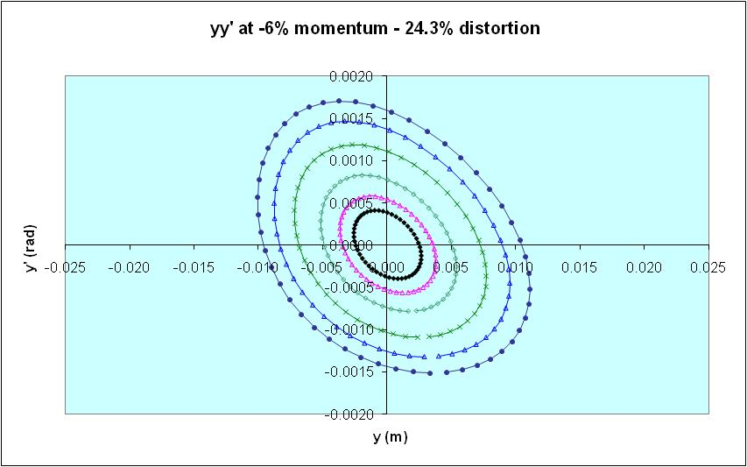
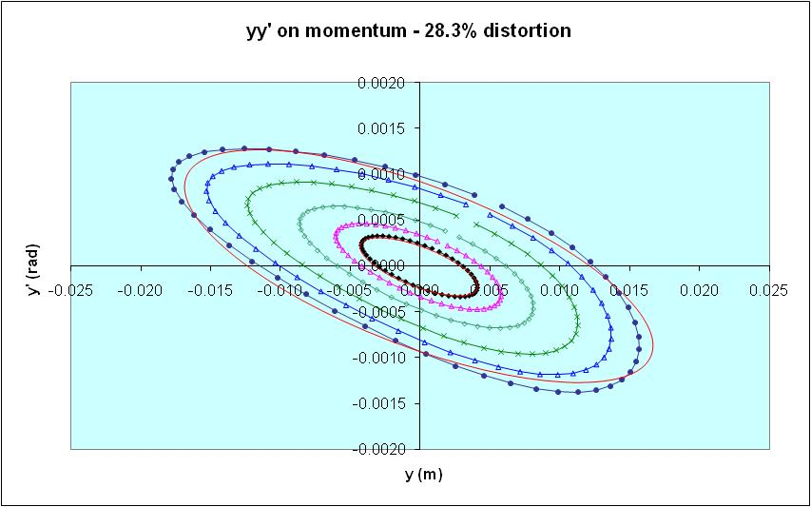
Guesstimates
Checked large-amplitude behavior during system design – nonpathological
Momentum Acceptance quite large (assuming energy compression; smaller if on crest/in trough)
Physical acceptance ~3” full aperture
0.0375 m amplitude acceptance at max. beam envelope (~50 m)
ε_{max} ~ (0.0375 m)²/50 m ~ 30 mm-mrad geometric
~6000 mm-mrad normalized (@ 100 MeV)
(Need to repeat analysis after beam/target interaction is characterized)

Slide 10
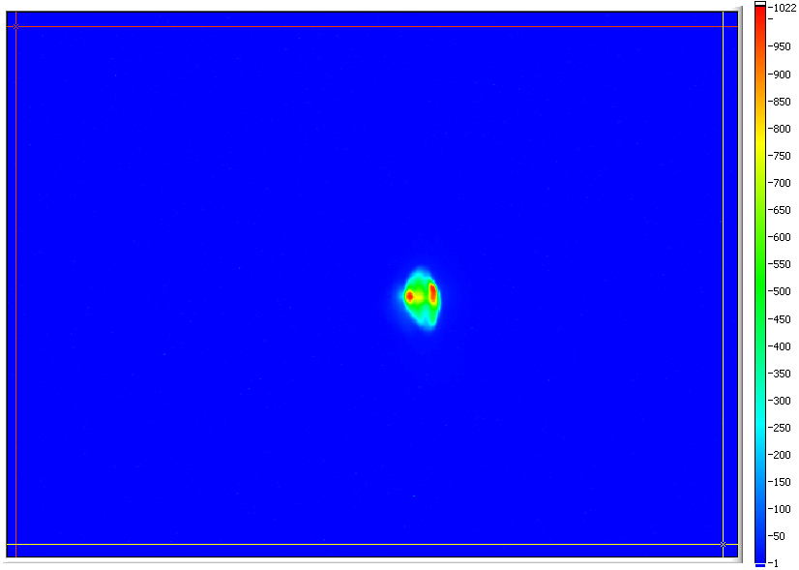
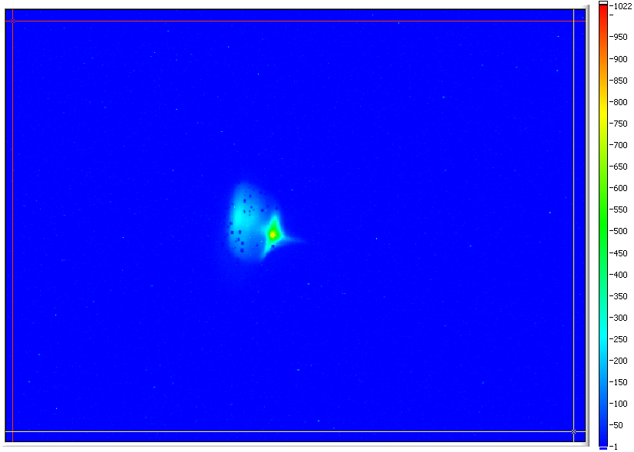
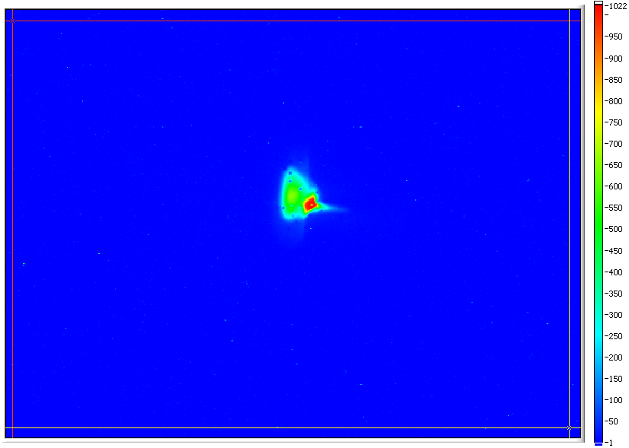
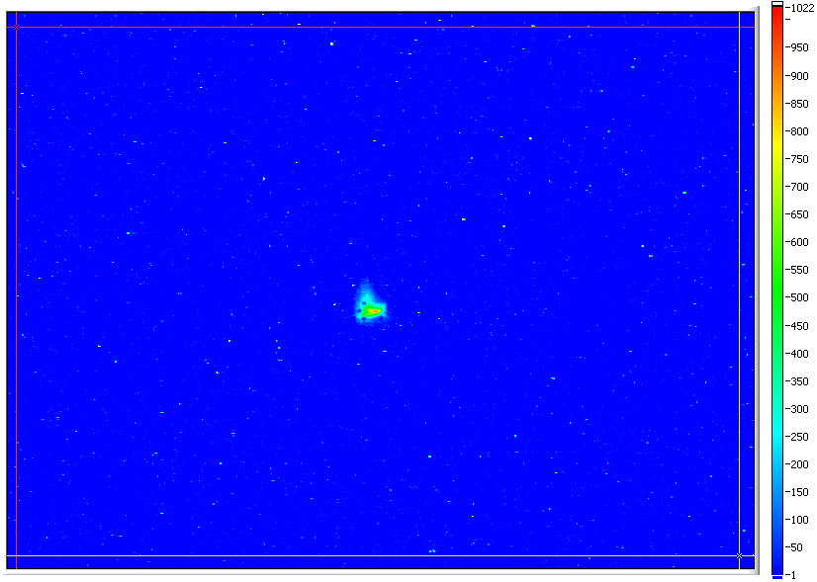
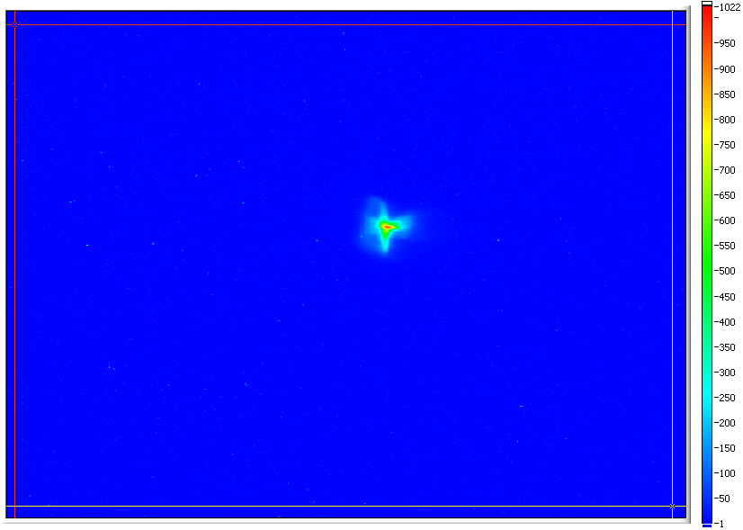
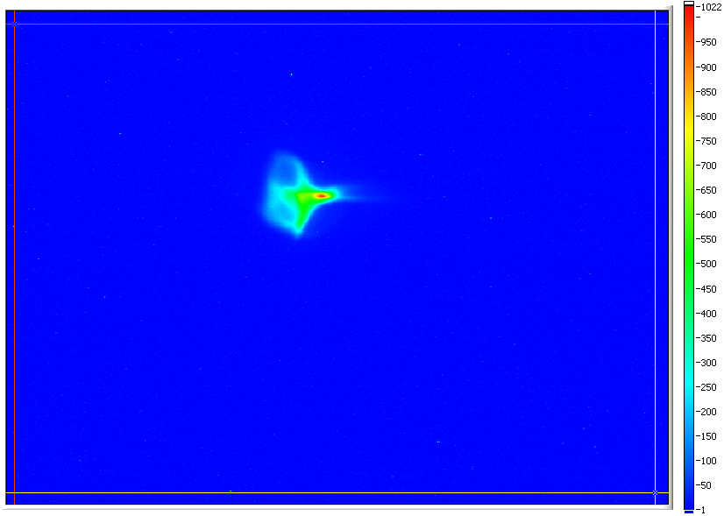
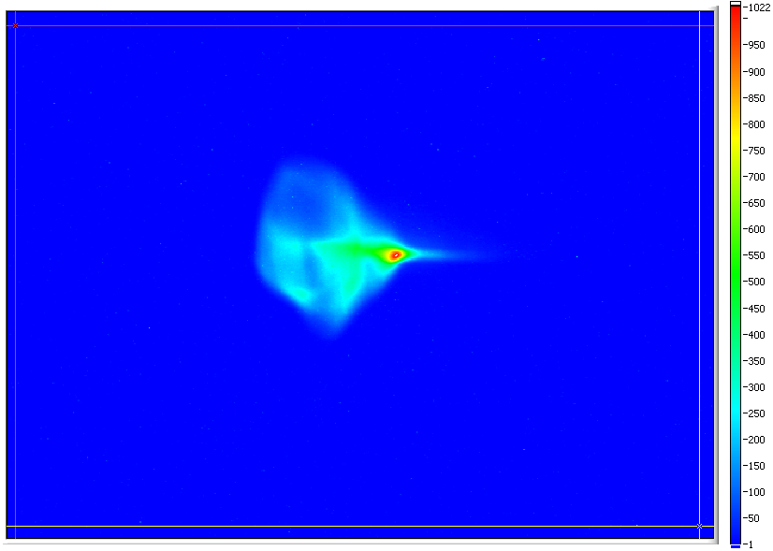
“Real beams do not occur in distributions named after dead European mathematicians” – P. O’Shea
Images courtesy P. Evtushenko

Slide 11
“core” vs. “edge” vs. “halo”
Beam is extremely nonuniform
In some places the transverse distribution looks like 2 or 3 superposed gaussians in one or both directions
In dispersed locations, the beam shows structure (filamentation) that appears to evolve through the system
We are forced to match “edge” of beam – the place the distributions all seem to tail off
Tried to match “core”, but which core do you match?
Hard to pick “which core is which” at different places or focusing settings
Core emittance smaller (~5-8 mm-mrad) but results inconsistent
Get shorter bunch, but raw detector signal is lower, implying you’re seeing only a fraction of the charge [hence, “match dependence of bunch length”]
Lasing not as good as when edges matched (longer bunch but more charge participates)
Picking a core to match causes mismatch in the others and in the halo, which gets very bad… (scraping)

Slide 12
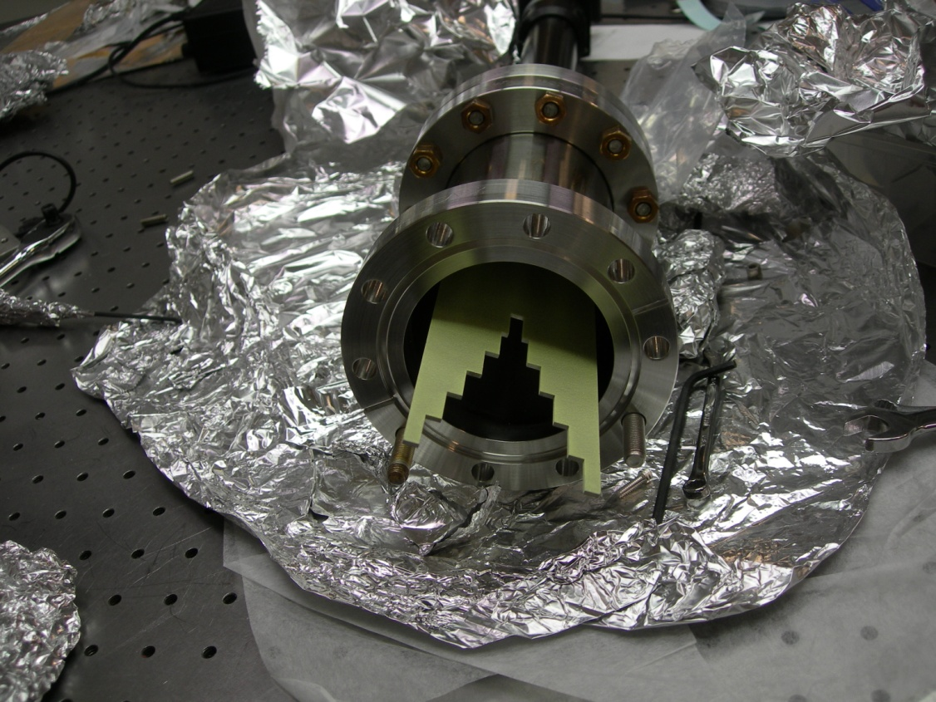
Halo – when seeking the Grail (beam brightness), its “the violence inherent in the system…”
Halo = the large-amplitude “low”-intensity stuff you can’t use that scrapes off, messes up data, activates components, and burns things up
Example: 10 mA CW ⬄ 1 μA loss tolerance => 10⁻⁴ relative loss upper limit
“the” major high-power ERL operational constraint
Beam loss, background radiation, activation, component damage…
Higher powers => worse halo effects
Comes from many sources, including drive laser, cathode, gun, beam formation processes, Satan, SRF cavities…
We see (and to some extent, manage) halo effects all the time
Halo components “mismatched” from core beam, can usually be managed with tuning knobs that don’t affect core beam too much
“magic” quads
octupoles
Have (historically) run high-duty factor (60 Hz) beam through small aperture (“halo monitor”) without evident loss
Significant concern in this situation
Small target aperture
Detector background
(Need to characterize halo (next talk…), establish tolerance & demonstrate control with small aperture)

Slide 13
Conclusions, Status, To-Do Lists
Can support detector (UV side of machine)
Can appropriately configure beam for DarkLight target
need to spec detailed beam properties (optimum spot size, momentum spread) & generate machine tunings
Need to establish impact of target on beam & generate recovery tuning
review spatial acceptance, evaluate recovery matching (transverse & longitudinal)
Need to establish stability specs
May need low-bandwidth stabilization (a la CEBAF)
Halo management
characterize halo
demonstrate control through small aperture

